Slide 1



Dr Angela Jackson
A LONG WAY TO THE TOP

Slide 2

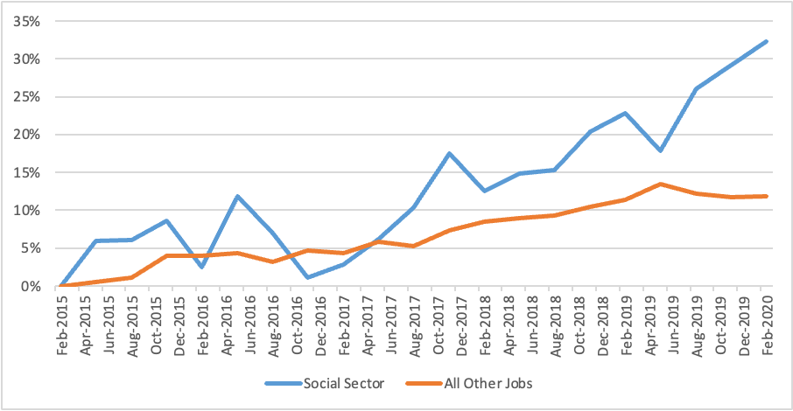
Sector Overview
NSW Social Services Sector employs 240,000 people and provides services to 1 million people each year.
Pre-Pandemic Growth in Jobs

Slide 3
Women Dominate - But Not Leadership
75 per cent of workers
are women
20 per cent of Board Chairs
are women
45 per cent of CEOs
are women

Slide 4
Differences Across Organisations
  27 per cent of CEOs in faith-based organisations are women vs 50 per cent of CEOs in secular organisations.
  30 per cent of Board Chairs in faith-based organisations are women vs 20 per cent of Board Chairs in secular organisations.

Slide 5
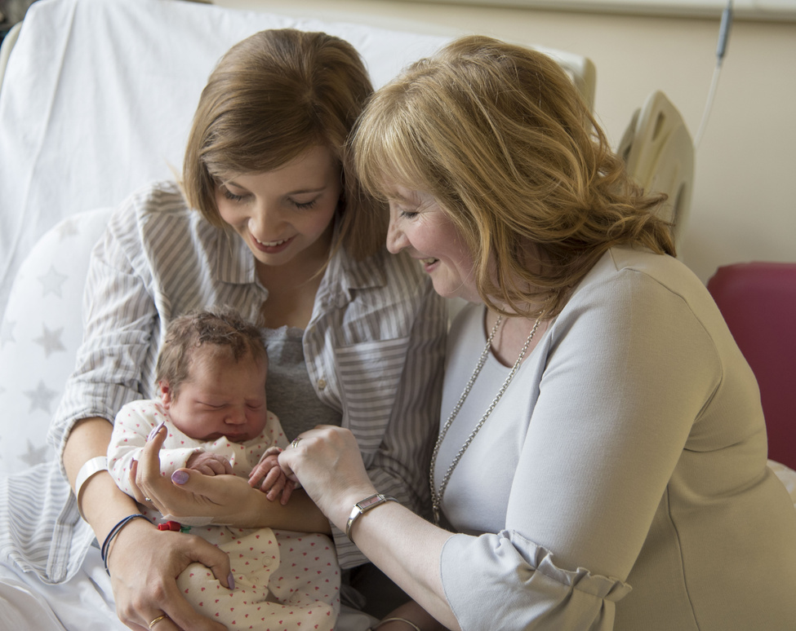




  Do women have the same opportunities as men in your organisation?
No
7%
Sometimes
27%
Yes
66%

Slide 6
What does your organisation do to retain, support and develop women employees?
On Job Mentoring and Support
Professional Development
Diversity Policies
Parental Leave
Flexible Work
0
25
50
75

Slide 7
  Diversity an Issue
Only 33 per cent thought their organisation did enough to attract, support, develop and promote women from diverse backgrounds
No, it does not do enough
21%
Yes, it's very strong
33%
Progress has been made but more is required
46%

Slide 8



Stress Burnout a Major Issue
60 per cent of respondents report burnout and stress as barrier to women in their organisaiton
‘Pay is low and burnout rate is high.’
‘The pandemic has shown our sector is fragile and at breaking point. I am sick of being expected to jump through endless hoops for our pollies and bureaucrats, yet I am paid at 28 hours per week and have to work over 40 hours per week. I am considering going back to public service. The stress and pressure has taken a toll, this is not sustainable.’

Slide 9
Pay Inadequate
  Technicians and trade workers earn 7.2 per cent more per hour than community and personal service workers.
  22 per cent of community and personal service workers have Bachelor degrees or higher, compared to 13.2 per cent of technicians and trade workers.
  Community and personal service workers with post-school qualifications earn 11.8 per cent more than workers without qualifications.
  Technicians and trade workers with post-school qualifications earn 24.6 per cent more than workers without qualifications.
44 per cent reported that better pay and conditions outside the social services sector was an issue for women in their organisation

Slide 10
Pay Not Keeping Up With Cost of Living
Location | Role | Proportion of Weekly Income on Rent (2 Bedroom House)
 |  | Dec-19 | Dec-21
 |  | (%) | (%)
Gosford and Central Coast | Support Worker – Home Care | 38% | 46%
Sydney | Aged Care Worker | 88% | 83%
Newcastle | Child Care Worker | 52% | 62%

Slide 11

Shortages
Worsening
Region | Growth in Vacancies January 2020-January 2021 (%)
Blue Mountains, Bathurst & Central West | 31%
Gosford & Central Coast | 52%
Illawarra & South Coast | 27%
NSW North Coast | 27%
Newcastle & Hunter | 18%
Riverina & Murray | 14%
Southern Highlands & Snowy | 66%
Tamworth and North-West NSW | 40%
Sydney | 53%

Slide 12


50 per cent not sure or see themselves leaving sector in 5 years time
120,000 additional workers needed to fill these losses ++
63,000 needed by 2030

Slide 13

Wages
The NSW Government should:
  Back in the current wage case to lift wages for aged care workers by 25 per cent; and
  Advocate for and support changes to the Fair Work Act to include gender equality as an express object, removing the need for a ‘male comparator’ and establishing a new Fair Work Commission gender equality panel.

Slide 14


Security of
Entitlements
Paid Parental
Leave
The NSW Government should introduce a scheme that provides portability of entitlements, including long service leave, within the NSW social services sector, similar to schemes introduced in the ACT and Victoria.
The NSW Government should advocate for the Commonwealth Government to extend the period of paid parental leave under the national scheme to at least 26 weeks, shared across the primary and secondary carer.

Slide 15

Diversity
Boards in the social services sector should:
  Actively encourage women to join their ranks and take on the role of chairperson;
  Take necessary steps to develop female leadership capabilities and pathways, assess their organisation’s gender pay gap and take corrective action to close it;
  Co-design, implement and monitor organisational diversity strategies to attract, support, retain and promote women from diverse backgrounds; and
  Review and update policies supporting flexible work arrangements and paid parental leave to reflect best practice.

Slide 16

Leadership
The NSW Government should establish a NSW Workforce Innovation and Development Institute in partnership with the higher education, VET, and social service sectors. The Institute should progress:
  An Industry Development Plan (including a workforce growth strategy);
  Initiatives to address system blockages, facilitate career pathways and support leadership development;
  Building an integrated dataset encompassing all areas of the social services workforce to inform planning, growth and transformation
  A comprehensive research program; and
  Tailored education and training opportunities, alongside practical support, to address the needs of the sector and priority groups and local communities.

Slide 17

Adequate Funding and Certainty
The NSW Government should:
  Increase funding across the sector by 20 per cent to address chronic underfunding, and equip the sector to respond to the ongoing impacts of the COVID-19 pandemic; and
  Commit to continuity of funding, longer-term contracts and adequate indexation as the norm, to support secure jobs, a stable work environment and better career opportunities for women.

Slide 18
Thank you
Dr Angela Jackson
angela.jackson@impacteconomics.com.au

